Slide 1
WHY ENCRYPTION?
Objectives of cryptography:
There are four main objectives of cryptography:-
a). Confidentiality: It guarantees that the sensitive
information can only be accessed by those users/entities
authorized to unveil it.
b). Data integrity: It is a service which addresses the
unauthorized alteration of data. This property refers to data
that has not been changed, destroyed, or lost in a malicious or
accidental manner.
c). Authentication: It is a service related to identification.
This function applies to both entities and information itself.
Two parties entering into a communication should identify
each other.
d). Non-repudiation: It is a service which prevents an entity
from denying previous commitments or actions.

Slide 2
TYPES
Cryptography involves two main approaches:
Symmetric-key cryptography.
Asymmetric-key cryptography.
Symmetric-key cryptography: Same secret key is used for
both encryption and decryption.
Asymmetric-key cryptography: Two different keys are used
i.e. one for encryption and other for decryption.

Slide 3
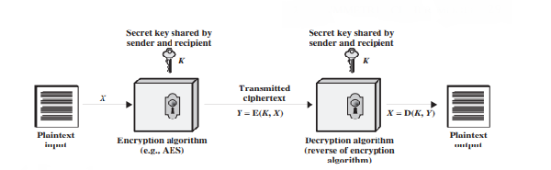
SIMPLIFIED MODEL OF SYMMETRIC CRYPTO SYSTEM

Slide 4
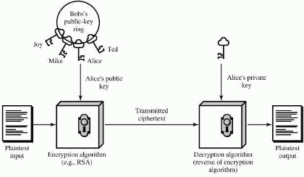
SIMPLIFIED MODEL OF ASYMMETRIC CRYPTO SYSTEM

Slide 5
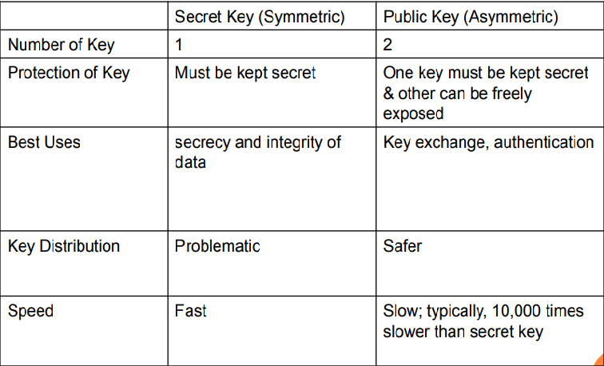
COMPARISON OF SECRET KEY AND PUBLIC KEY

Slide 6
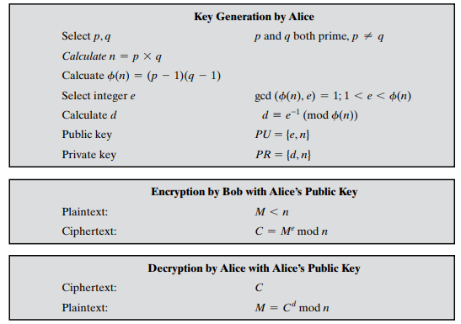
RSA

Slide 7
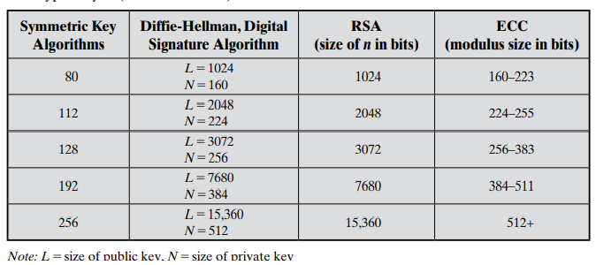
The main interest of the elliptic curve cryptosystems is to decrease the required key-size to achieve appropriate security. Thus, we have an equivalent security level among RSA algorithm using 1024-bit key and an elliptic curve cryptosystem using more or less a 160-bit key. The following comparison table given by NIST in [SP800-57] perfectly illustrates the key size benefits of using elliptic curves based cryptography:

Slide 8
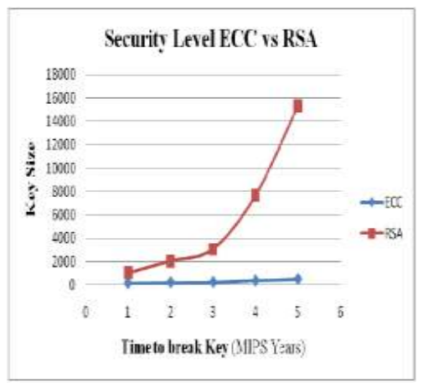

Slide 9

ECC
RSA

Slide 10
ECC-WHAT IS IT?
Elliptic curves are not ellipses. Elliptic curves are described by cubic equations similar to those used for calculating the circumference of an ellipse
Elliptic curve cryptography makes use of elliptic curves, in which the variables and coefficients are all restricted to elements of a finite field
An elliptic curve is defined by an equation in two variables with coefficients.

Slide 11
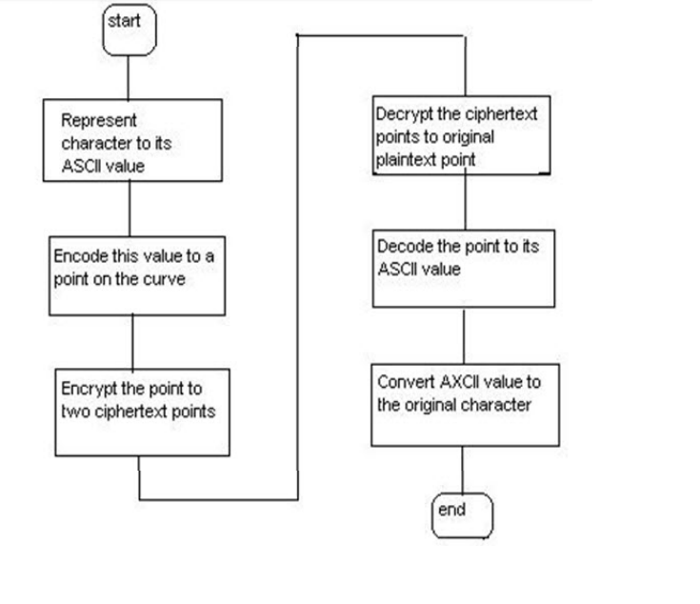
HOW IT RUNS?

Slide 12
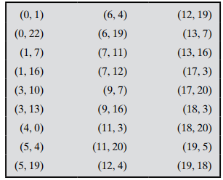
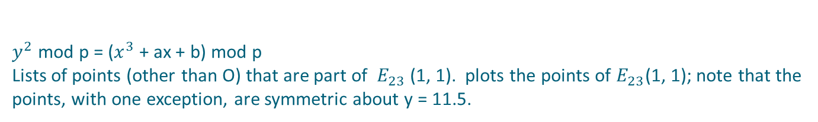
$y^{2}$mod p = ($x^{3}$+ ax + b) mod p Lists of points (other than O) that are part of $E_{23}$(1, 1). plots the points of $E_{23}$(1, 1); note that the points, with one exception, are symmetric about y = 11.5.

Slide 13
Koblitz’s Method for Encoding Plaintext
Step1: Pick an elliptic curve Ep(a,b).
Step 2: Let us say that E has N points on it.
Step 3: Let us say that our alphabet consists of the digits 0,1,2,3,4,5,6,7,8,9 and the letters A,B,C,. . . , X,Y,Z coded as 10,11,. . . , 35.
Step 4: This converts our message into a series of numbers between 0 & 35.
Step 5: Now choose an auxiliary base parameter, for example k = 20. ( both parties should agree upon this)
Step 6: For each number mk (say), take x=mk + 1 and try to solve for y.
Step 7: If you can't do it, then try x = mk +2 and then x = mk +3 until you can solve for y.
Step 8: In practice, you will find such a ‘y’ before you hit x = mk + k - 1. Then take the point (x,y). This now converts the number m into a point on the elliptic curve. In this way, the entire message becomes a sequence of points.

Slide 14

HOW IS KEY GENERATED?
Both the entities in the cryptosystem agree upon a,b,p,G,n which are called Domain Parameters of G is called generator point and n is the order of G.
Now A generates a random number nA< n as his private Key and calculates his public key
Set $P_{A}$= G+G+G +…..nA times.
B generates a random number nB< n as his private Key and calculates his public key.
set $P_{B}$= G+G+G +….nB times.

Slide 15
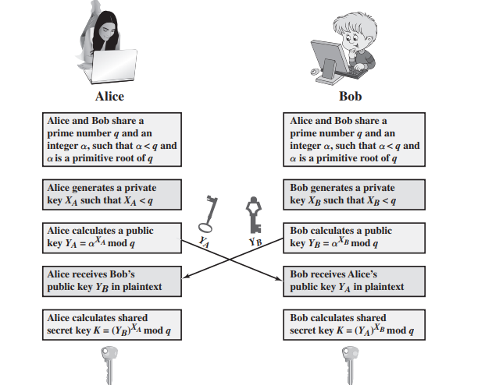
KEY EXCHANGE

Slide 16
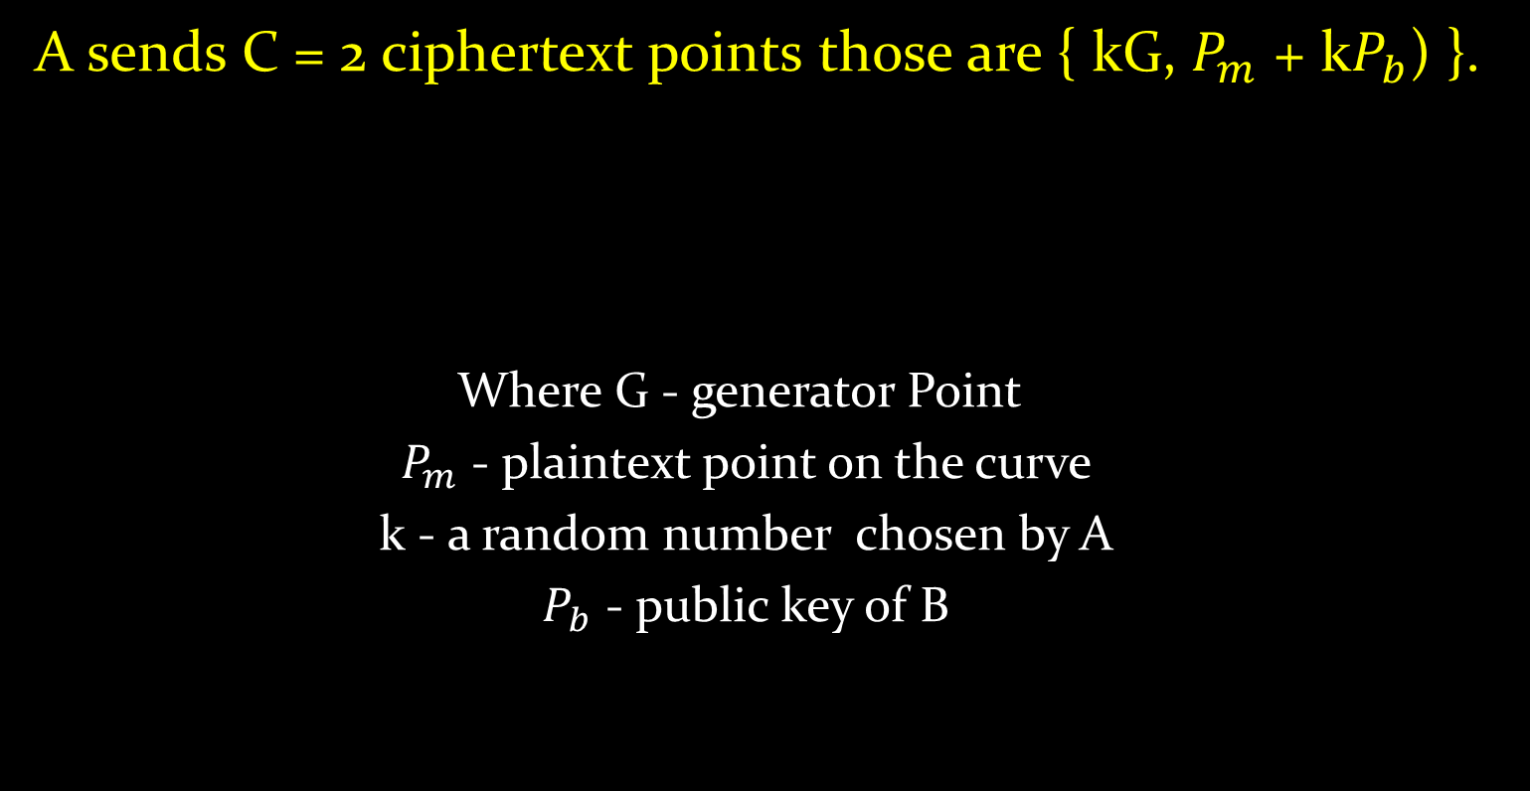
ENCRYPTION
A sends C = 2 ciphertext points those are { kG, $P_{m}$ + k$P_{b}$) }.
Where G - generator Point
$P_{m}$ - plaintext point on the curve
k - a random number chosen by A
$P_{b}$ - public key of B

Slide 17
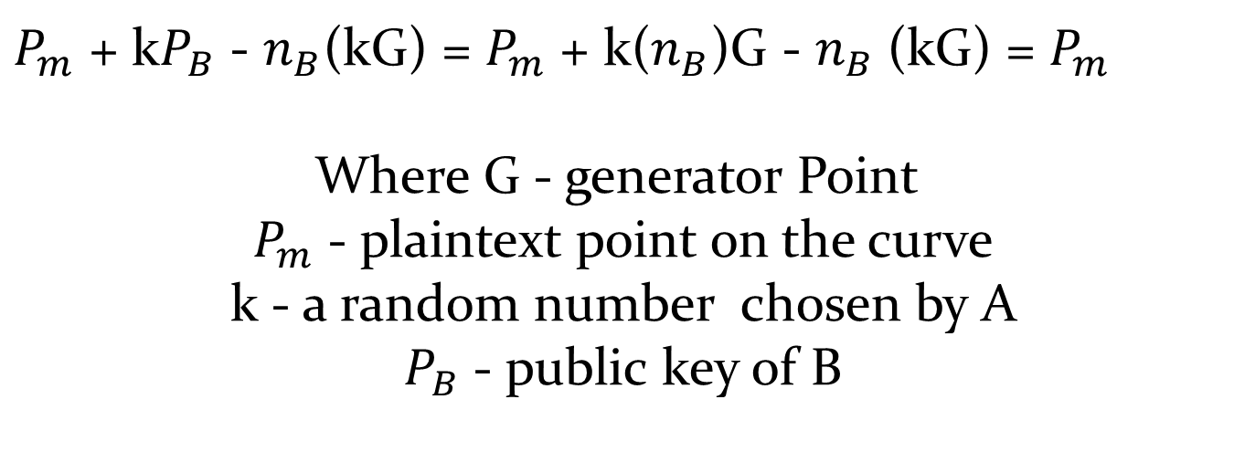
DECRYPTION
$P_{m}$+ k$P_{B}$- $n_{B}$(kG) = $P_{m}$+ k($n_{B}$)G - $n_{B}$(kG) = $P_{m}$
Where G - generator Point
$P_{m}$ - plaintext point on the curve
k - a random number chosen by A
$P_{B}$ - public key of B

Slide 18
AN EXAMPLE
Example: Say the parameters of curve are: p(751),a(-1),b(188),n(727).
Say we have to send character ‘b’.
‘B’ is first encoded as number 11.
x=mk+1 i.e, 11*20+1=221cannot solve it for a y such that y^2 = x^3 + ax+ b mod p
So go for x=mk+2 , x=222 , no y exists. x=mk+3, x=223, no y exists.
x=mk+4 so x=224 can solve it for y and y=248.
Now the point (224,248) is point is encrypted and decrypted as a message.
To decode just compute (x-1)/k i.e, (224-1)/20=223/20 i.e, 11.15.
Return 11 as original plaintext(greatest integer less than (x-1)/k ,that is 11.
The number 11 is now decoded to character ‘B’.
The probability that we fail to find a square (and hence fail to associate m to a point) is about (½)^k .

Slide 19
OUR PROGRESS
function [X,Y,n] = PC(A,B,p)
This function m-file finds and plots all the points that lie in E_p(A,B)
These points are on the curve y^2 = x^3 + AX + B (mod p)
function [x3,y3,m] = ECADP(x1,y1,x2,y2,A,p)
This function m-file performs Elliptic Curve addition over prime curves.
Suppose we are working on the elliptic curve y^2 = x^3 + Ax + B
Define P1 = (x1,y1)
P2 = (x2,y2)
Then P1 + P2 = P3 = (x3,y3) is defined by as below
If one if the variables in infinity then we define P + infinity = P
and the user should type in ’infinity’ for both the x and y values.
function [X2,Y2] = SUCDOB(X1,Y1,k,A,p)
This is a function m-file to perform the successive doubling algorithm
on prime curves. If P = (X1,Y1) and k is an integer, then this algorithm
will find kP = (X2,Y2) where we are operating over the elliptic curve
y^2 = x^3 + Ax + B (mod p), p prime

Slide 20
OUR PROGRESS
function [flag] = check(x,y,A,B,p)
An m-file to check if the point (x,y) lies on the prime curve
y^2 = x^3 + Ax + B (mod p)
function [I] = inve(N,p)
This m-file finds the inverse of an element, N, in the group Z_p
for use with prime curves.
function [x10,y,c] = ECC(x,y,a,b,M,x9,n)
function [c1,c2,X6,Y6]=encrypt(X2,Y2,X,Y,a,p,n)
function [X14,Y14,c,str_back_to_char]=decrypt(x1,y1,X,Y,n,a,b,p,z,c)
Main function
M = input('\nEnter the message: ','s'); % ASCII TO MESSAGE CONVERSION

Slide 21
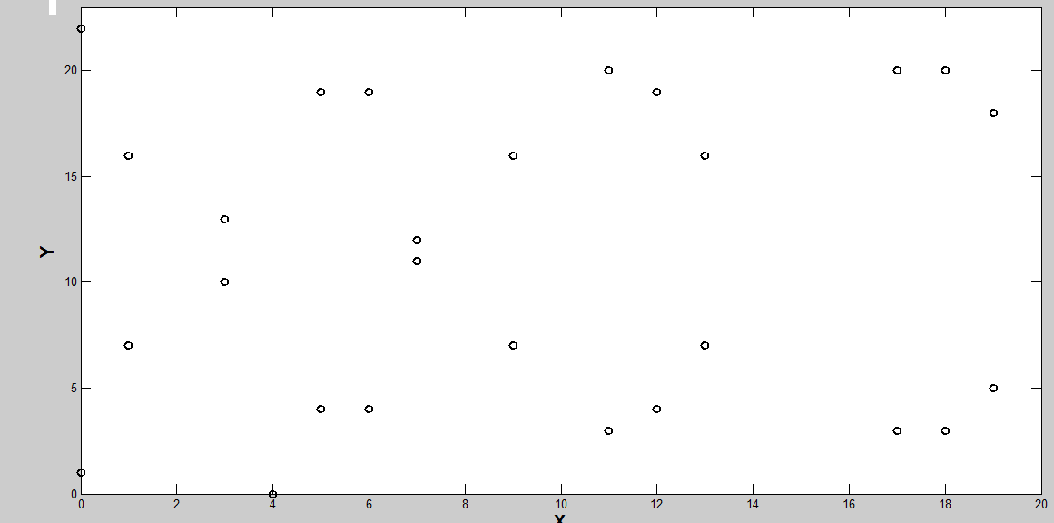
Let us look more closely
The set of points for a=b=1 and p=23
Output of PC.m

Slide 22
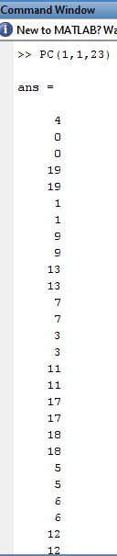
Output of PC.m

Slide 23
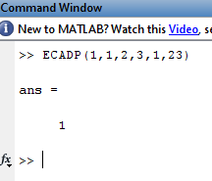
Output of ECADP.m

Slide 24
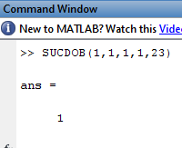
Output of SUCDOB.m

Slide 25
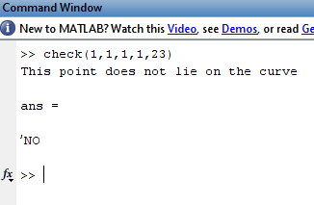
Output of check.m

Slide 26
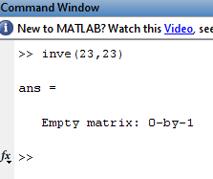
Output of inve.m

Slide 27
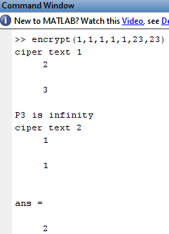
Output of encrypt.m

Slide 28
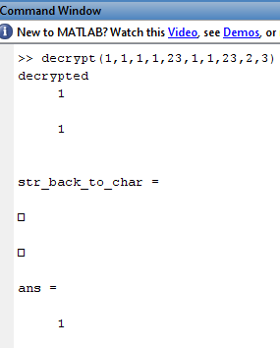
Output of decrypt.m

Slide 29
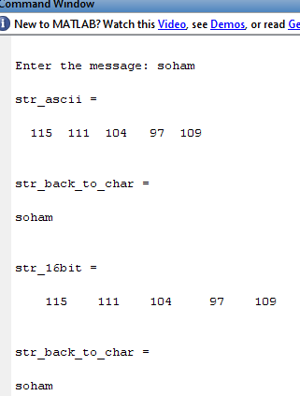
ASCII to Message

Slide 30
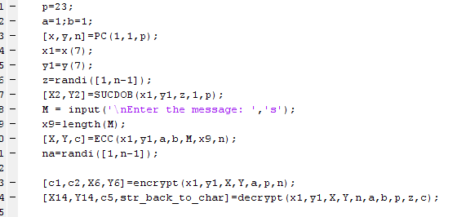
ECC implementation in Matlab

Slide 31
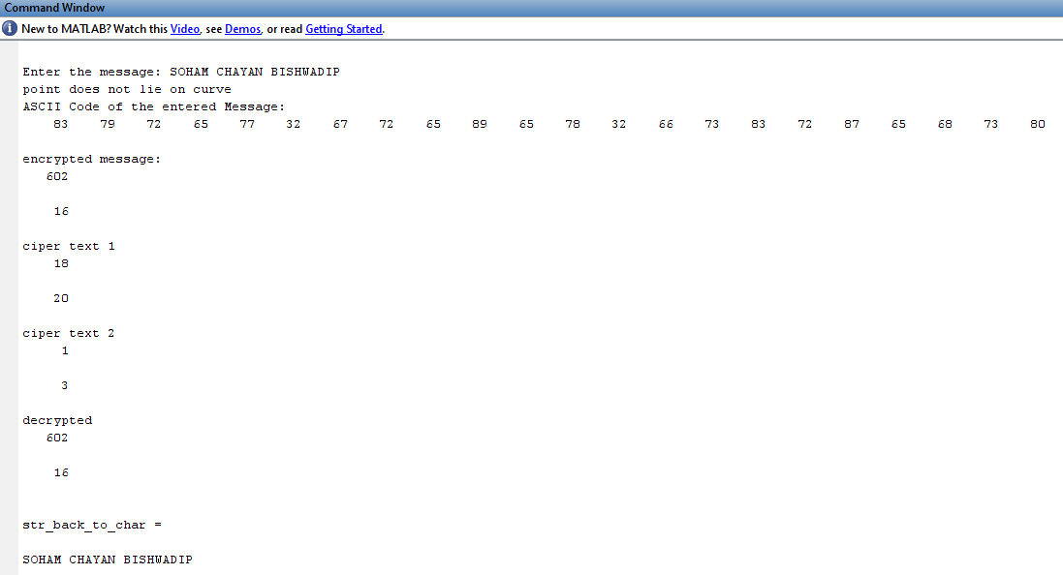
Final Output

Slide 32

SOHAM MONDAL
BISHWADIP PAUL
CHAYAN DUTTA
Presented By-
Dept of ETCE(UG-III)

